Slide 1


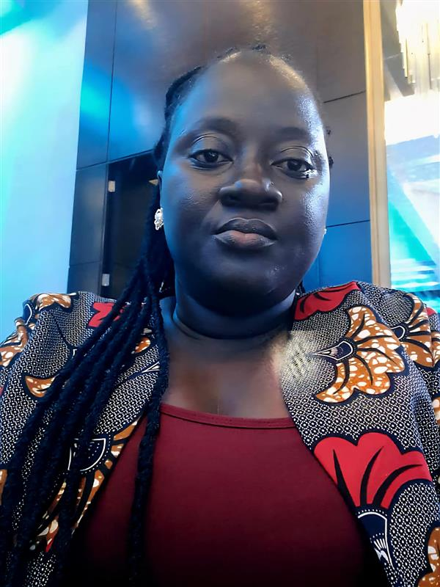
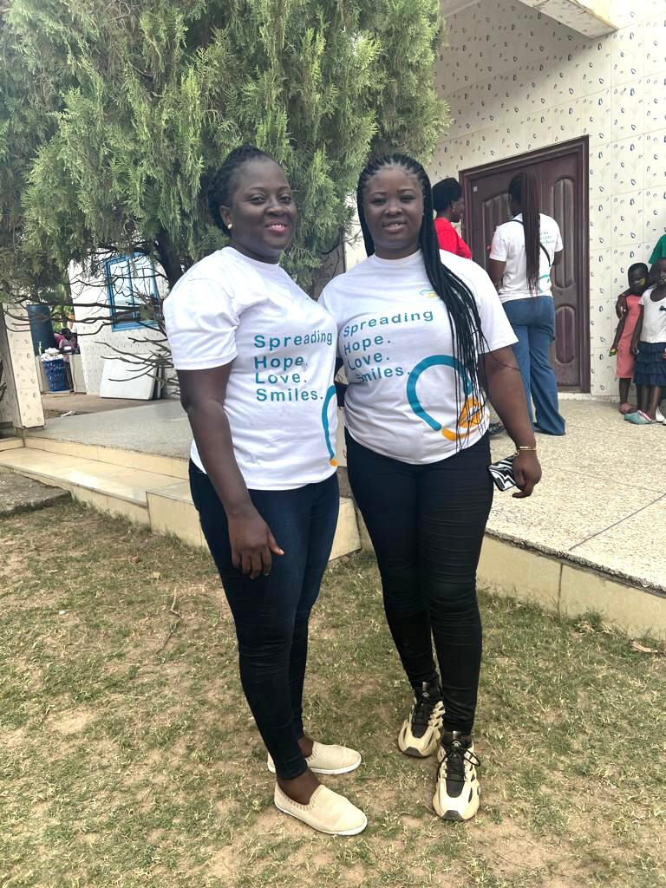
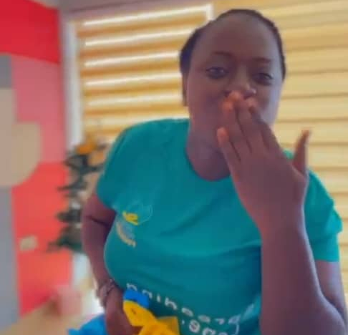
Getting to Know Me
Work
Personal
My role
ZONAL HEAD
Significant others / family members / furry friends in my life
MY FAMILY, PATNER AND MY-HELP FOUNDATION
Tenure in ofi/Olam
7MONTH
How I enjoy spending my free time
READING, COOKING AND SHARING WITH THE NEEDY AND THE LESS PRIVILLAGE
Previous companies I have worked at
WWBG AND MY-HELP YOUR-HELP FOUNDATION
My favorite / comfort food
HOT COFFEE WITH A TOAST, FUFU AND GROUNDUNT SOUP
Why I joined ofi/Olam and what keeps me here?
THE ROLE PRESENTED A STRONG OPPORTUNITY FOR CAREER GROWTH. IT ALLOWS ME TO TAKE ON GREATER LEADERSHIP RESPONSIBILITES.
My favorite song
FRAGRANCE BY DUNSIN OYEKAN
THERESA AMOAH
‘what name you prefer to be called’
A few fun facts about me
KOFI KINAATA’S MUSIC IS ALWAYS ON MY PLAYLIST – HIS LYRICS HIT DEEP AND VIBE JUST RIGHT
This is me outside work, doing stuff I enjoy in my life …

